Slide 1
Engaging the Patient in Healthcare: Conversational Assistants in the era of LLMs
Barbara Di Eugenio
University of Illinois Chicago
Chicago, IL, USA

Slide 2

Challenges Incarnated
Virtual Health Coach: support patients (and human
coaches) in adopting SMART goals via SMS exchanges
HFChat: conversational agent for Heart Failure patient
education

Slide 3



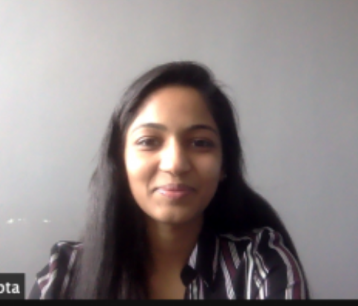




HFChat DPI Seed award, National Science Foundation 2232307 (2022-2025)
5 Collaborators – 4 colleges
3 Phd Students

Slide 4
HFChat: Conversational agent for African American patients with heart failure (HF)
Hypothesis: African-American (AA) patients who have access to culturally competent health care information will make better informed self-care choices
Goals:
Uncover self-care concerns of AA patients with HF
Explore neuro-symbolic approaches to dialogue agents
Evaluate LLMs and take advantage of them if appropriate
Challenge: No formalized method to model and evaluate cultural competence

Slide 5
20 Patient / Educator interactions
Standard Heart Failure (HF) education information comprises:
what HF is
medications - ``water pill" (diuretic)
importance of low sodium diet
benefits of physical activity
daily checks to recognize symptoms
value of follow-up appointments
Avg/dialogue | Patient | Educator
Turns | 108 (48%) | 117 (52%)
Sentences | 131 (39%) | 205 (61%)
Words | 850 (27%) | 2280 (73%)
Notes:
Patient educator: specific figure
18 AA/ 2H – 1AA/1H/1W

Slide 6
Excerpt of patient-educator conversation [Gupta et al 2020]
---- Patient Control
Patient: Yeah, I don’t, I don’t do the frozen meal.
Educator: Okay.
Patient: I was basically doing the uh, vegetables.
Educator: Okay.
Patient: Frozen vegetables
---- Educator Control
Educator: They should be fine.
Patient: Yeah.
Educator: But... but, but I do want you to start looking at those nutrition labels.
Patient: Okay.
Educator: So, the other we always want you to do is, um, of course take all your medicines like
you’re supposed to.
---- Patient Control
Patient: Which I didn’t do last night.
- what topics/ issues are important to these patients for self care? Use initiative [Walker & Whittaker 1990]

Slide 7
Three prototypes on salt intake
HFChat [Gupta et al 2021]: based on Google DialogFlow
Pilot evaluation with 9 patients: Only 32% of questions answered correctly
HFFood-NS [Tayal et al 24, 26]: NeuroSymbolic architecture
based on PPTOD [Su et al 22]
HFFood-GPT [Tayal et al 26]: Based on GPT4

Slide 8
HFFood-NS: Synthetic Dataset [Tayal et al 24]
Template based conversational dataset (MultiWOZ [Budzianowski et al 2018])
Conversation alternates between user and system
Slots: include food, cook, type, part, food weight, metric [USDA food DB fields]
System questions: one slot at a time; user responses randomly selected from template
Types of user responses:
Matching answers
Misaligned answers
Revised answers
# Dialogues | 87,425
# Turns | 525,392
Avg Turn/Dialogue | 6
Notes:
Misaligned: The user provides information unrelated to the system’s query
Potentially SKIP. – can skip this one and not next. If skip this one, say on next – trained on 87,000K artificial conversations

Slide 9
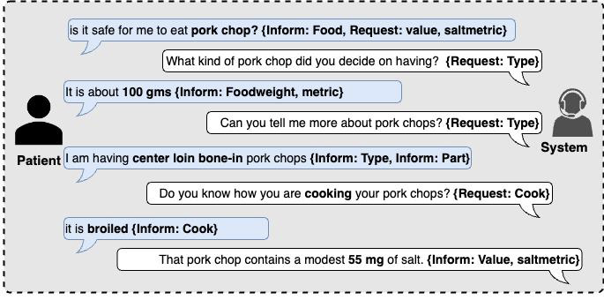
Synthetic Conversation example

Slide 10
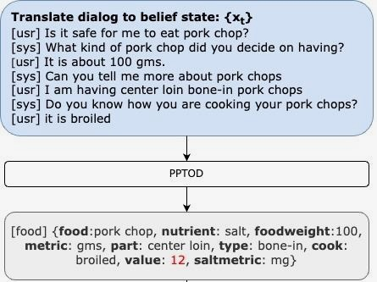
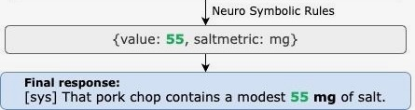
HFFood-NS [Tayal et al SigDIAL 24]
PPTOD (Plug-and-Play Task Oriented Dialog System) [Su et al 22]
● T5 based - designed for task-oriented dialogue
● Trained on synthetic dataset
● Performance: correctly identified most slot values but not salt values
HFFood-NS: Adds neuro-symbolic rules
● Retrieval of accurate salt value from database
● Calculation of correct salt value for queried food weights (based on USDA Food Composition
Database)
Notes:
Dataset of 87,000 conversations to train
Potentially skip

Slide 11
HFFood-GPT - Prompt
Sodium Scout greets users warmly and helps analyze the salt content in various foods. It methodically asks users about the food type, cooking method, and portion size, one question at a time, to accurately determine the salt content.
Using values from a provided JSON file, Sodium Scout calculates the estimate salt content and compares it to the recommended daily intake of 2000mg. It advises that foods exceeding 20% of this intake are not recommended, while those below 5% are favorable choices.
Sodium Scout refrains from giving health advice and suggesting consulting a professional for dietary guidance. Answers are kept under 40 words, and it only searches the data provided in the JSON file. Users do not know about the data file, so don't discuss it. Only focus on information related to food and their salt amount. Do not look for information on the web.

Slide 12
Within-subject User Study [Tayal et al LREC 26]
20 AA, hospitalized patients interact first with HFFood-NS, then with HFFood-GPT, or viceversa (balanced order)
Health Literacy & Digital Literacy were assessed with validated instruments (BRIEF [Haun et al 2009]; eHEALS [Norman & Skinner 2006])
Asked 5 questions of first system, same questions of second system
Evaluation: system accuracy (salt values, slot values, hallucinations); post-survey questionnaire; readability

Slide 13
Additional details
Systems identified only as Lion (HFCHat-NS) / Shark (HFChat-GPT)
Balanced presentation: one patient starts with Shark, next with Lion
Minimalistic User Interface on tablet:
two radio buttons to select system: Shark/Lion
one button to indicate whether system is recording or listening
Both systems use same Speech Recognizer: OpenAI Whisper-1 [Radford et al 23]
HFFood-NS: if slot unfilled asks twice, leaves unfilled after that

Slide 14
HFFood-NS vs HFFood-GPT: intrinsic metrics
 | HFFood-NS | HFFood-GPT
Task completion | 84% | 62%
Salt value accuracy | 37% | 24%
Slot accuracy | 56% | 89%

Slide 15
User questionnaire: no preferences

Slide 16
HFFood-NS vs HFFood-GPT: observations
 | HFFood-NS | HFFood-GPT
Allows Error Analysis | ✓ | ✘
Reliable | ✓ | ✘
Handles Complex Queries | ✘ | ✓
Fluent | ✘ | ✓
Concise | ✓ | ✘
Faster to deploy | ✘ | ✓
HFFood-GPT Prompt: keep answer max 40 words avg = 51 words

Slide 17
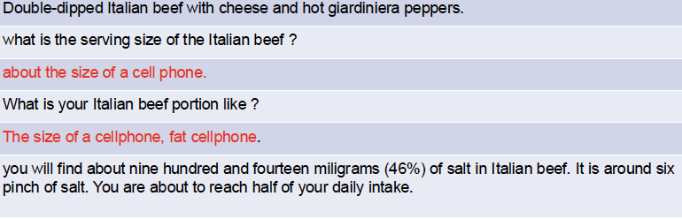
Complex user queries / unexpected expressions
“What is the sodium content in two grilled hot links with three ounces of barbecue sauce?” (more difficult for HFFood-NS)

Slide 18
Che pedante questo GPT …
System: Thank you for specifying the preparation method. Now, could you please tell me the portion size of the grilled turkey sausage in grams?
User: 5 milligrams.
System: It seems there might be a misunderstanding with the portion size. Typically, food portion sizes are measured in grams (g) and would be much larger than 5 milligrams (mg). Could you please provide the portion size again in grams? For reference, a common serving size for sausage might be around 50 to 150 grams.
User: 100 milligrams
System: It looks like we're still not quite accurate on the portion size. When we're talking about turkey sausage, the realistic portion size is usually around 100 grams (g), not milligrams (mg). One gram is equal to 1000 milligrams, so a portion size of turkey sausage might be 100 grams (which is 100,000 milligrams), for instance. Could you clarify the portion size in grams for the turkey sausage?

Slide 19
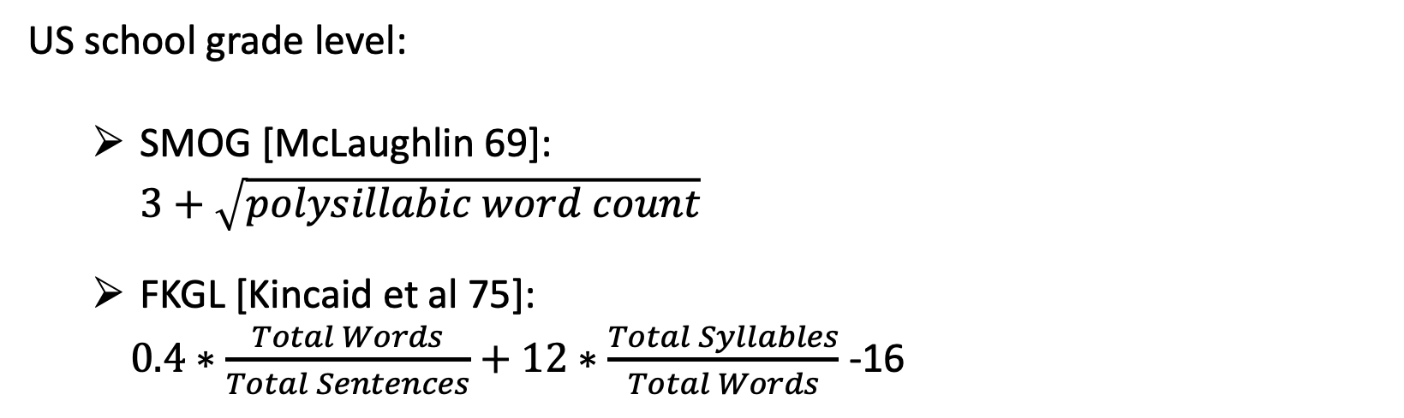
HFFood-NS vs HFFood-GPT: Response readability
Healthcare information should be at 6th grade reading level (prima media)
US grades: 1-12
SMOG better for healthcare
[Wong et al 13, Mac et al 22]
US school grade level:
SMOG [McLaughlin 69]:
$3+\sqrt{polysillabic word count}$
FKGL [Kincaid et al 75]:
$0.4∗\frac{Total Words}{Total Sentences}+12∗\frac{Total Syllables}{Total Words}$ -16
Notes:
(AI summary)
The Flesch-Kincaid Grade Level (FKGL) and the Simple Measure of Gobbledygook (SMOG) are both readability formulas used to estimate the U.S. school grade level required for a reader to understand a text
. While both are common in assessing health information, they differ in their metrics, focus, and strictness.
Key Differences:
Metric Focus: FKGL measures average sentence length and average syllables per word. SMOG focuses on the percentage of words with three or more syllables (polysyllabic words).
Sensitivity: SMOG is generally considered more accurate for health applications as it correlates with 100% comprehension, whereas FKGL is broader.
Scoring Tendencies: SMOG often yields a higher grade level (i.e., indicates the text is harder to read) than FKGL, frequently by 2–3 grades.
Recommended Use: While FKGL is widely used, SMOG is preferred for healthcare materials because it ensures higher readability standards (100% comprehension).

Slide 20
HFFood-NS vs HFFood-GPT: Response readability
Reading ease:
FKRE [0..100] [Flesh 48, Kincaid et al 75]
$206.835 −1.015 ∗\frac{Total Words}{Total Sentences} −84.5 ∗\frac{Total Syllables}{Total Words}$
 | HFFood-NS | HFFood-GPT
SMOG (↓) [grade] | 7.05 | 10.58
FKGL (↓) [grade] | 2.71 | 7.10
FKRE (↑) [ease] | 91.21 | 71.79
Notes:
(AI summary)
The Flesch-Kincaid Grade Level (FKGL) and the Simple Measure of Gobbledygook (SMOG) are both readability formulas used to estimate the U.S. school grade level required for a reader to understand a text
. While both are common in assessing health information, they differ in their metrics, focus, and strictness.
Key Differences:
Metric Focus: FKGL measures average sentence length and average syllables per word. SMOG focuses on the percentage of words with three or more syllables (polysyllabic words).
Sensitivity: SMOG is generally considered more accurate for health applications as it correlates with 100% comprehension, whereas FKGL is broader.
Scoring Tendencies: SMOG often yields a higher grade level (i.e., indicates the text is harder to read) than FKGL, frequently by 2–3 grades.
Recommended Use: While FKGL is widely used, SMOG is preferred for healthcare materials because it ensures higher readability standards (100% comprehension).

Slide 21
HFCHat: take aways
Dataset: collected 20 patient/educator conversations (not sharable); generated synthetic dataset
Bias / fairness: meant to address cultural competence for AA (Hispanics too). To be continued
Neurosymbolic approaches: developed HFFood-NS
LLMs: currently, uncertain utility
Doesn’t follow prompt instructions; hallucinations
Too high reading level

Slide 22
Current and Future Work (especially HFChat)
Cultural Competence: ”you know when you see it”
Patient-centered care: empathy, respect, curiosity, responsiveness
Health-belief model [Hochbaum 1958, Rosestock 2000] & Persuasiveness: perceived [susceptibility to risk; risk severity; benefits of action, barriers to action]; self-efficacy; cues to action
Extend to other domains – via schema graphs used to control LLMs [Agrawal et al SigDIAL 24, Zhang et al EMNLP 23, Zhao et al EMNLP 23]
Bias …

Slide 23
References
I. Gupta, B. Di Eugenio, B. Ziebart, A. Baiju, B. Liu, B. Gerber, L. Sharp, N. Nabulsi, and M. Smart. Human-human health coaching via text messages: Corpus, annotation, and analysis. In Proceedings of the 21th Annual Meeting of the Special Interest Group on Discourse and Dialogue, pages 246–256, 1st virtual meeting, July 2020. Association for Computational Linguistics.
I. Gupta, B. Di Eugenio, B. Ziebart, B. Liu, B. Gerber, and L. Sharp. Goal summarization for human-human health coaching dialogues. In The Thirty-Third International FLAIRS Conference, 2020.
I. Gupta, B. Di Eugenio, B. D. Ziebart, B. Liu, B. S. Gerber, and L. K. Sharp. Summarizing behavioral change goals from SMS exchanges to support health coaches. In Proceedings of the 22nd Annual Meeting of the Special Interest Group on Discourse and Dialogue, pages 276–289, 2021.
Gupta, Itika, Barbara Di Eugenio, Devika Salunke, Andrew Boyd, Paula Allen-Meares, Carolyn Dickens, and Olga Garcia. "Heart failure education of African American and Hispanic/Latino patients: Data collection and analysis." In Proceedings of the First Workshop on Natural Language Processing for Medical Conversations, pp. 41-46. 2020.
Mac, O., et al . (2022). Comparison of Readability Scores for Written Health Information Across Formulas Using Automated vs Manual Measures. JAMA Network Open, 5(12)
C. Raffel, N. Shazeer, A. Roberts, K. Lee, S. Narang, M. Matena, Y. Zhou, W. Li, and P. J.Liu. Exploring the limits of transfer learning with a unified text-to-text transformer. Journal of Machine Learning Research, 21(140):1–67, 2020.
Su, Y., Shu, L., Mansimov, E., Gupta, A., Cai, D., Lai, Y.-A., and Zhang, Y.: Multi-task pre-training for plug-and-play task-oriented dialogue system. In Proceedings of the 60th Annual Meeting of the Association for Computational Linguistics (Volume 1: Long Papers), eds. S. Muresan, P. Nakov, and A. Villavicencio, pages 4661–4676, Dublin, Ireland, May 2022. Association for Computational Linguistics.

Slide 24
References (ctd)
Tayal, Anuja, Barbara Di Eugenio, Devika Salunke, Andrew Boyd, Carolyn A. Dickens, Eulalia P. Abril, Olga Garcia-Bedoya, and Paula G. Allen-Meares. "A neuro-symbolic approach to monitoring salt content in food." In Proceedings of the First Workshop on Patient-Oriented Language Processing (CL4Health)@ LREC-COLING 2024, pp. 93-103. 2024.
Y. Zhou, B. Di Eugenio, B. Ziebart, L. Sharp, B. Liu, B. Gerber, N. Agadakos, and S. Yadav. Towards enhancing health coaching dialogue in low-resource settings. In Proceedings of the 29th International Conference on Computational Linguistics, pages 694–706, Gyeongju, Republic of Korea, Oct. 2022. International Committee on Computational Linguistics.
Y. Zhou, B. Di Eugenio, B. Ziebart, L. Sharp, B. Liu, and N. Agadakos. Modeling lowresource health coaching dialogues via neuro-symbolic goal summarization and text-units text generation. In N. Calzolari, M.-Y. Kan, V. Hoste, A. Lenci, S. Sakti, and N. Xue, editors, Proceedings of the 2024 Joint International Conference on Computational Linguistics, Language Resources and Evaluation (LREC-COLING 2024), pages 11498–11509, Torino, Italia, May 2024. ELRA and ICCL.
Y. Zhou, B. Di Eugenio, and L. Cheng. Unveiling performance challenges of large language models in low-resource healthcare: A demographic fairness perspective. In O. Rambow, L.Wanner, M. Apidianaki, H. Al-Khalifa, B. D. Eugenio, and S. Schockaert, editors, Proceedings of the 31st International Conference on Computational Linguistics, pages 7266–7278, Abu Dhabi, UAE, Jan. 2025. Association for Computational Linguistics.
Y. Zhou and B. Di Eugenio. Veracity bias and beyond: Uncovering LLMs’ hidden beliefs in problem-solving reasoning. In W. Che, J. Nabende, E. Shutova, and M. T. Pilehvar, editors, Proceedings of the 63rd Annual Meeting of the Association for Computational Linguistics (Volume 1: Long Papers), pages 21298–21310, Vienna, Austria, July 2025. Association for Computational Linguistics.

